Slide 1
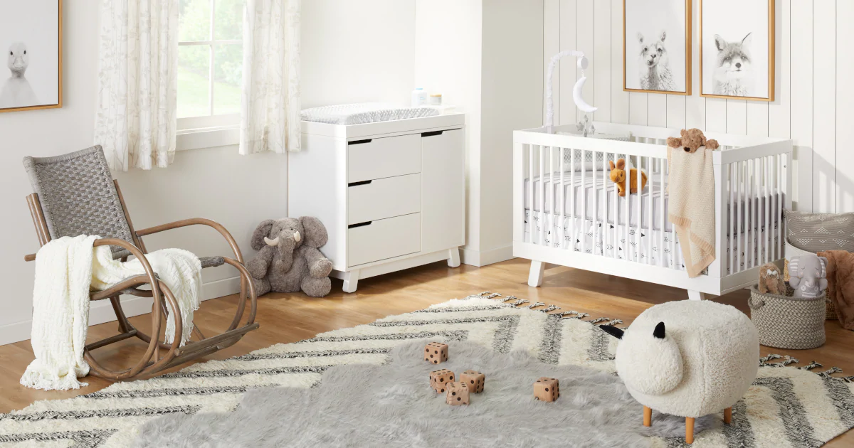
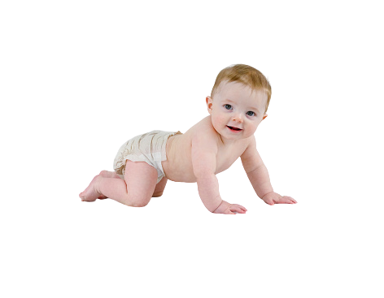
A Comparison of Video-based Methods
Members
Outlines of Presentation
For Neonatal Body Motion Detection
2022 44th Annual International Conference of
the IEEE Engineering in Medicine & Biology Society (EMBC)
Scottish Event Campus, Glasgow, UK, July 11-15, 2022
GROUP - III
1

Slide 2

A Comparison of Video-based Methods
GROUP - III
Members
Outlines of Presentation
What is preterm birth?
Background story
Abstract
Datasets
Methods
Evaluation
Results
Discussion
Create monitoring system
Mg Thwin Htoo Aung 5IST-1
Mg Ye Win Htet 5IST-11
Mg Chan Min Ko 5IST-12
Mg Mabu Phong 5IST-13
Ma Khine Thet Thet Zaw 5IST-16
For Neonatal Body Motion Detection
Effects of preterm birth?
2022 44th Annual International Conference of
the IEEE Engineering in Medicine & Biology Society (EMBC)
Scottish Event Campus, Glasgow, UK, July 11-15, 2022
2

Slide 3
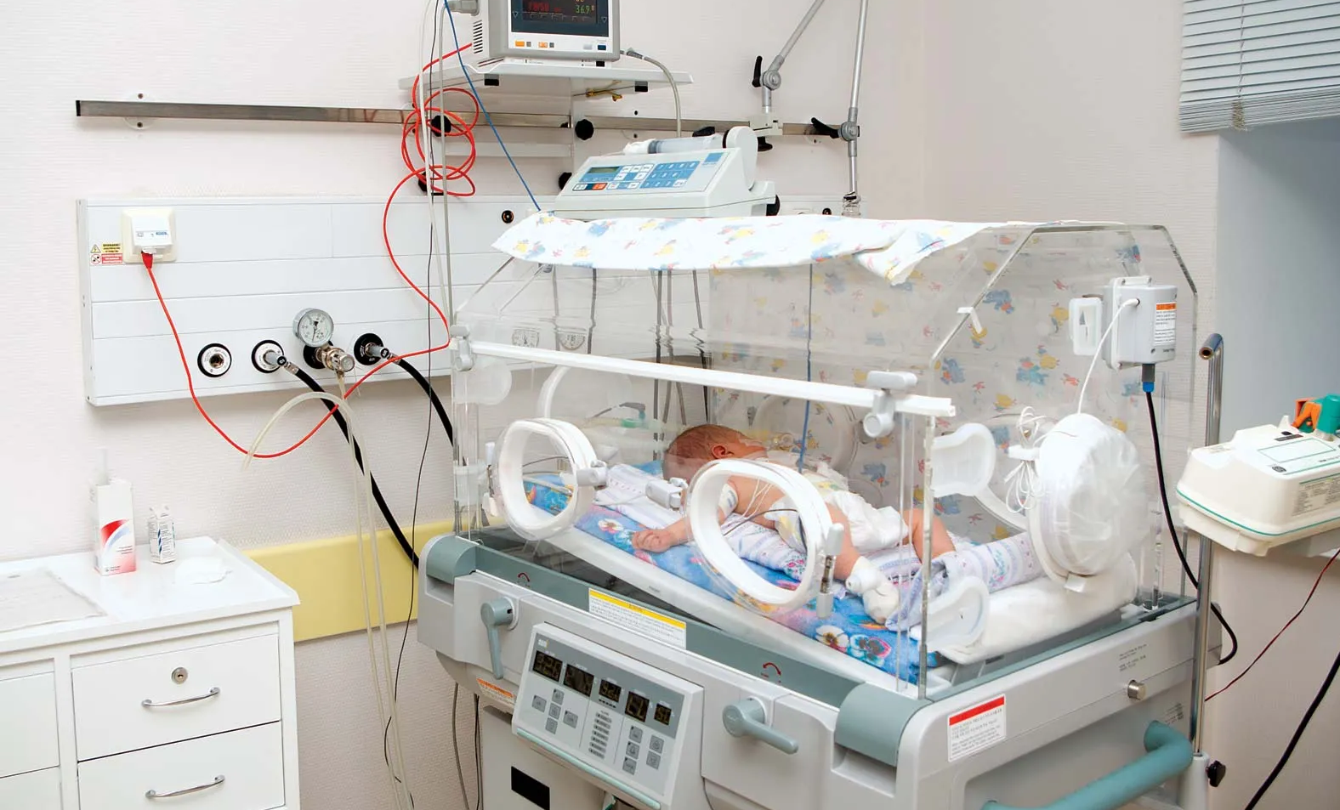
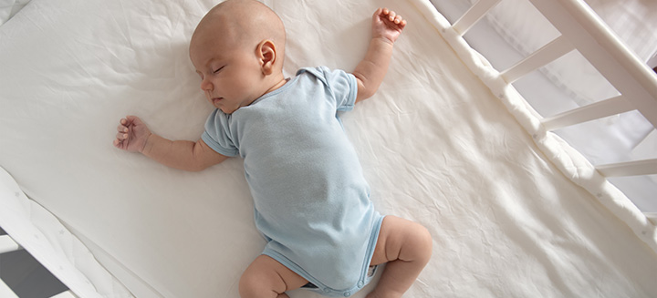
A Comparison of Video-based Methods
Mg Thwin Htoo Aung 5IST-1
Mg Ye Win Htet 5IST-11
Mg Chan Min Ko 5IST-12
Mg Mabu Phong 5IST-13
Ma Khine Thet Thet Zaw 5IST-16
Background story
Abstract
Datasets
Methods
Results
Discussion
Members
GROUP - 3
Outlines of Presentation
What is preterm birth?
Create monitoring system
For Neonatal Body Motion Detection
Background Story
Effects of preterm birth?
2022 44th Annual International Conference of
the IEEE Engineering in Medicine & Biology Society (EMBC)
Scottish Event Campus, Glasgow, UK, July 11-15, 2022
3

Slide 4
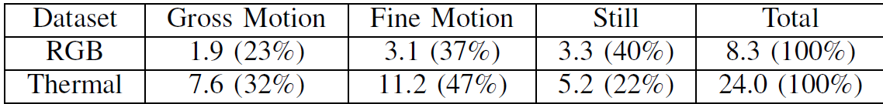
A Comparison of Video-based Methods
Mg Thwin Htoo Aung 5IST-1
Mg Ye Win Htet 5IST-11
Mg Chan Min Ko 5IST-12
Mg Mabu Phong 5IST-13
Ma Khine Thet Thet Zaw 5IST-16
Background story
Abstract
Datasets
Methods
Results
Discussion
Members
GROUP - 3
Outlines of Presentation
What is preterm birth?
Create monitoring system
To compare the performance and
the computation time of
four video-based methods
for motion detection in preterm
infants, including BS, SOF, DOF, and ORB.
For Neonatal Body Motion Detection
Abstract
Effects of preterm birth?
2022 44th Annual International Conference of
the IEEE Engineering in Medicine & Biology Society (EMBC)
Scottish Event Campus, Glasgow, UK, July 11-15, 2022
4
Three classes that focus on . . .

Slide 5
A Comparison of Video-based Methods
Mg Thwin Htoo Aung 5IST-1
Mg Ye Win Htet 5IST-11
Mg Chan Min Ko 5IST-12
Mg Mabu Phong 5IST-13
Ma Khine Thet Thet Zaw 5IST-16
Background story
Abstract
Datasets
Methods
Results
Discussion
Members
GROUP - 3
Outlines of Presentation
RGB Datasets | Thermal Datasets
An RGB Camera (UI-3860LE-C-HQ) | Three thermal cameras (FLIR Lepton 2.5)
Resolution 1280 x 720 pixels - 10fps | Resolution of 60 x 80 pixels - 9 fps
Placed on top of the incubator | Placed around the infants’ beds
To capture the head and upper body | Merged to observe infants from different directions simultaneously
9-hour videos from 5 infants | 32-hour thermal videos from 13 infants
Mean PMA of 31.2 (2.1) weeks | mean PMA of 36.7 (3.3) weeks
What is preterm birth?
Create monitoring system
To compare the performance and
the computation time of
four video-based methods
for motion detection in preterm
infants, including BS, SOF, DOF, and ORB.
For Neonatal Body Motion Detection
Datasets
Effects of preterm birth?
2022 44th Annual International Conference of
the IEEE Engineering in Medicine & Biology Society (EMBC)
Scottish Event Campus, Glasgow, UK, July 11-15, 2022
Three classes that focus on . . .
5
Four methods are . . .
Background Substruction (BS)
Sparse Optical Flow (SOF)
Dense Optical Flow (DOF)
Oriented FAST and Rotated BRIEF (ORB).

Slide 6
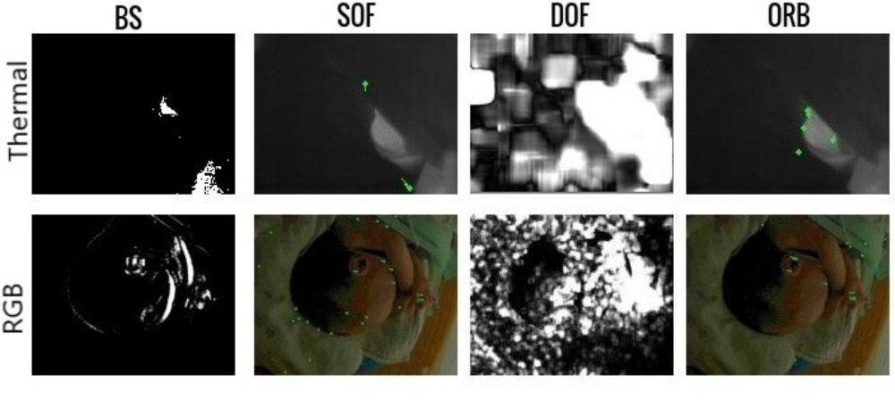
A Comparison of Video-based Methods
Mg Thwin Htoo Aung 5IST-1
Mg Ye Win Htet 5IST-11
Mg Chan Min Ko 5IST-12
Mg Mabu Phong 5IST-13
Ma Khine Thet Thet Zaw 5IST-16
Background story
Abstract
Datasets
Methods
Results
Discussion
Members
GROUP - 3
Outlines of Presentation
Before apply to each methods,
Each frame was transformed into a grayscale image and normalized by a histogram equalization to improve efficiency and contrast.
RGB Datasets | Thermal Datasets
An RGB Camera (UI-3860LE-C-HQ) | Three thermal cameras (FLIR Lepton 2.5)
Resolution 1280 x 720 pixels - 10fps | Resolution of 60 x 80 pixels - 9 fps
Placed on top of the incubator | Placed around the infants’ beds
To capture the head and upper body | Merged to observe infants from different directions simultaneously
9-hour videos from 5 infants | 32-hour thermal videos from 13 infants
Mean PMA of 31.2 (2.1) weeks | mean PMA of 36.7 (3.3) weeks
Methods
What is preterm birth?
Create monitoring system
To compare the performance and
the computation time of
four video-based methods
for motion detection in preterm
infants, including BS, SOF, DOF, and ORB.
Four methods are . . .
For Neonatal Body Motion Detection
Background Substruction (BS)
Sparse Optical Flow (SOF)
Effects of preterm birth?
Dense Optical Flow (DOF)
2022 44th Annual International Conference of
the IEEE Engineering in Medicine & Biology Society (EMBC)
Scottish Event Campus, Glasgow, UK, July 11-15, 2022
Three classes that focus on . . .
Oriented FAST and Rotated BRIEF (ORB).
6

Slide 7
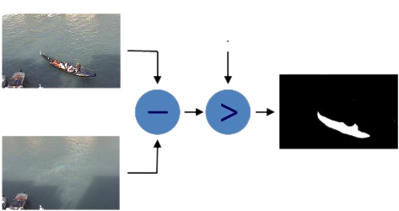
A Comparison of Video-based Methods
Mg Thwin Htoo Aung 5IST-1
Mg Ye Win Htet 5IST-11
Mg Chan Min Ko 5IST-12
Mg Mabu Phong 5IST-13
Ma Khine Thet Thet Zaw 5IST-16
Background story
Abstract
Datasets
Methods
Results
Discussion
Members
GROUP - 3
Outlines of Presentation
Background Substruction (BS)
RGB Datasets | Thermal Datasets
An RGB Camera (UI-3860LE-C-HQ) | Three thermal cameras (FLIR Lepton 2.5)
Resolution 1280 x 720 pixels - 10fps | Resolution of 60 x 80 pixels - 9 fps
Placed on top of the incubator | Placed around the infants’ beds
To capture the head and upper body | Merged to observe infants from different directions simultaneously
9-hour videos from 5 infants | 32-hour thermal videos from 13 infants
Mean PMA of 31.2 (2.1) weeks | mean PMA of 36.7 (3.3) weeks
Before apply to each methods,
Each frame was transformed into a grayscale image and normalized by a histogram equalization to improve efficiency and contrast.
Methods
What is preterm birth?
Create monitoring system
Current frame
THRESHOLD
To compare the performance and
the computation time of
four video-based methods
for motion detection in preterm
infants, including BS, SOF, DOF, and ORB.
Foreground mask
For Neonatal Body Motion Detection
Background model
Sparse Optical Flow (SOF)
Effects of preterm birth?
The BS method uses the difference between the current
frame and a defined background model to detect the motion.
The background
model is needed to update to adapt to the impact of the changing
external environment such as light.
Dense Optical Flow (DOF)
2022 44th Annual International Conference of
the IEEE Engineering in Medicine & Biology Society (EMBC)
Scottish Event Campus, Glasgow, UK, July 11-15, 2022
Three classes that focus on . . .
Oriented FAST and Rotated BRIEF (ORB).
7

Slide 8
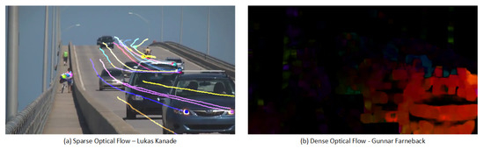
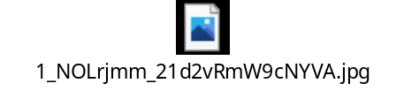
A Comparison of Video-based Methods
Mg Thwin Htoo Aung 5IST-1
Mg Ye Win Htet 5IST-11
Mg Chan Min Ko 5IST-12
Mg Mabu Phong 5IST-13
Ma Khine Thet Thet Zaw 5IST-16
Background story
Abstract
Datasets
Methods
Results
Discussion
Members
GROUP - 3
Outlines of Presentation
Sparse Optical Flow (SOF)
Dense Optical Flow (DOF)
RGB Datasets | Thermal Datasets
An RGB Camera (UI-3860LE-C-HQ) | Three thermal cameras (FLIR Lepton 2.5)
Resolution 1280 x 720 pixels - 10fps | Resolution of 60 x 80 pixels - 9 fps
Placed on top of the incubator | Placed around the infants’ beds
To capture the head and upper body | Merged to observe infants from different directions simultaneously
9-hour videos from 5 infants | 32-hour thermal videos from 13 infants
Mean PMA of 31.2 (2.1) weeks | mean PMA of 36.7 (3.3) weeks
Methods
What is preterm birth?
Create monitoring system
To compare the performance and
the computation time of
four video-based methods
for motion detection in preterm
infants, including BS, SOF, DOF, and ORB.
For Neonatal Body Motion Detection
Background Substruction (BS)
(A)Sparse optical flow
(A)Dense optical flow
The optical flow method uses the change of tracking points (motion vector with direction) between consecutive frames to detect motion.
Depending on the density of pixels that are tracked
by the optical flow method, the method can be categorized into SOF and DOF.
SOF only need to compute optical flow of some pixels(features, corners of interest object) from the whole image, DOF computes all the pixels.
Effects of preterm birth?
2022 44th Annual International Conference of
the IEEE Engineering in Medicine & Biology Society (EMBC)
Scottish Event Campus, Glasgow, UK, July 11-15, 2022
Three classes that focus on . . .
Oriented FAST and Rotated BRIEF (ORB).
8

Slide 9
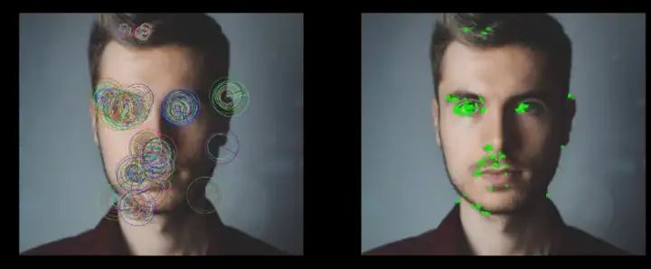
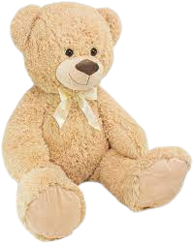
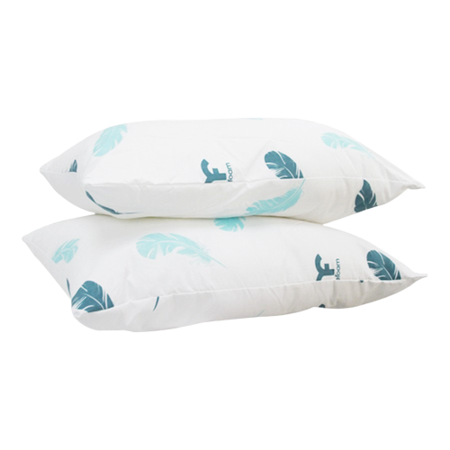
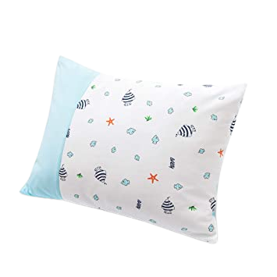
A Comparison of Video-based Methods
Mg Thwin Htoo Aung 5IST-1
Mg Ye Win Htet 5IST-11
Mg Chan Min Ko 5IST-12
Mg Mabu Phong 5IST-13
Ma Khine Thet Thet Zaw 5IST-16
Background story
Abstract
Datasets
Methods
Results
Discussion
Members
GROUP - 3
Outlines of Presentation
Oriented FAST and Rotated BRIEF (ORB).
RGB Datasets | Thermal Datasets
An RGB Camera (UI-3860LE-C-HQ) | Three thermal cameras (FLIR Lepton 2.5)
Resolution 1280 x 720 pixels - 10fps | Resolution of 60 x 80 pixels - 9 fps
Placed on top of the incubator | Placed around the infants’ beds
To capture the head and upper body | Merged to observe infants from different directions simultaneously
9-hour videos from 5 infants | 32-hour thermal videos from 13 infants
Mean PMA of 31.2 (2.1) weeks | mean PMA of 36.7 (3.3) weeks
Methods
What is preterm birth?
Create monitoring system
To compare the performance and
the computation time of
four video-based methods
for motion detection in preterm
infants, including BS, SOF, DOF, and ORB.
For Neonatal Body Motion Detection
Background Substruction (BS)
Sparse Optical Flow (SOF)
Effects of preterm birth?
Dense Optical Flow (DOF)
ORB first find features.( finds pixels that are significantly different
from neighbor pixels in a frame as tracking points.)
Afterwards, these tracking points in two
consecutive frames are compared whether it is matched or not.
2022 44th Annual International Conference of
the IEEE Engineering in Medicine & Biology Society (EMBC)
Scottish Event Campus, Glasgow, UK, July 11-15, 2022
Three classes that focus on . . .
9

Slide 10
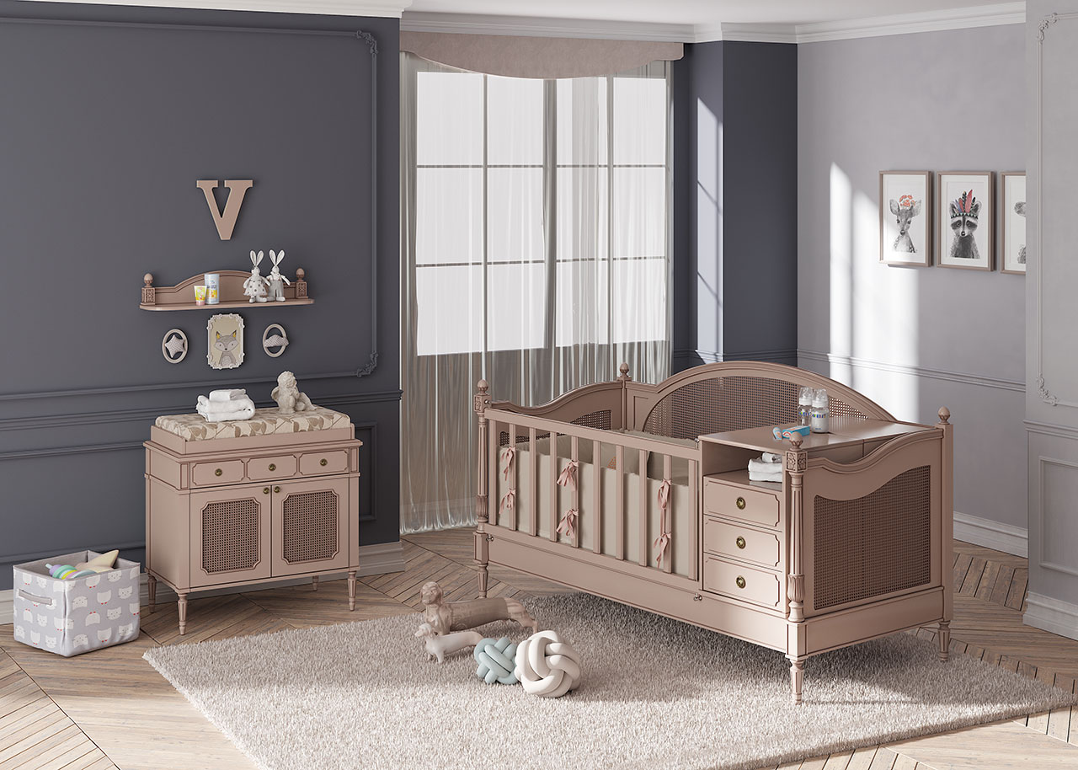

A Comparison of Video-based Methods
Mg Thwin Htoo Aung 5IST-1
Mg Ye Win Htet 5IST-11
Mg Chan Min Ko 5IST-12
Mg Mabu Phong 5IST-13
Ma Khine Thet Thet Zaw 5IST-16
Background story
Abstract
Datasets
Methods
Results
Discussion
Members
GROUP - 3
Outlines of Presentation
In the thermal dataset, BS outperforms the other methods with mean (SD) AUCs of 0.86 (0.03) and 0.93 (0.03) for both experiments.
Oriented FAST and Rotated BRIEF (ORB).
Evaluation
What is preterm birth?
Create monitoring system
Two experiment-motion detection & Gross motion detection.
Motion Detection is a combination of Gross motion and fine motion.
Gross Motion Detection is only gross motion.
To compare the performance and
the computation time of
four video-based methods
for motion detection in preterm
infants, including BS, SOF, DOF, and ORB.
In the RGB dataset, SOF performs best for motion detection and is as good as DOF when detecting gross motion.
For Neonatal Body Motion Detection
Background Substruction (BS)
The performance of SOF and ORB increases with higher video resolution, but has little influence on the performance of DOF.
Sparse Optical Flow (SOF)
Effects of preterm birth?
In the RGB dataset, the run time is always higher, particularly the run time of DOF increases largely at high resolution.
2022 44th Annual International Conference of
the IEEE Engineering in Medicine & Biology Society (EMBC)
Scottish Event Campus, Glasgow, UK, July 11-15, 2022
Dense Optical Flow (DOF)
ORB first find features.( finds pixels that are significantly different
from neighbor pixels in a frame as tracking points.)
Afterwards, these tracking points in two
consecutive frames are compared whether it is matched or not.
Using Python 3.8.3 with opencv-contrib-python 4.5.5.62 (CPU-only)
on a CPU of 2.60GHz (Intel Core i7-9750H)
with no architecture specific instruction.
The run time does not differ per method for the thermal data, which has a low resolution.
10

Slide 11
A Comparison of Video-based Methods
Mg Thwin Htoo Aung 5IST-1
Mg Ye Win Htet 5IST-11
Mg Chan Min Ko 5IST-12
Mg Mabu Phong 5IST-13
Ma Khine Thet Thet Zaw 5IST-16
Background story
Abstract
Datasets
Methods
Results
Discussion
Members
GROUP - 3
Outlines of Presentation
Results
In the thermal dataset, BS outperforms the other methods with mean (SD) AUCs of 0.86 (0.03) and 0.93 (0.03) for both experiments.
What is preterm birth?
R G B
Create monitoring system
Method | Motion Detection | Gross Motion Detection | Run Time (ms)
BS | 0.76 (0.13) | 0.89 (0.04) | 30.0 (1.80)
SOF | 0.82 (0.09) | 0.91 (0.05) | 28.9 (2.65)
DOF | 0.79 ( 0.11) | 0.91 (0.05) | 234 ( 3.40)
ORB | 0.77 (0.11) | 0.84 (0.06) | 36.2 (1.10)
In the RGB dataset, SOF performs best for motion detection and is as good as DOF when detecting gross motion.
To compare the performance and
the computation time of
four video-based methods
for motion detection in preterm
infants, including BS, SOF, DOF, and ORB.
For Neonatal Body Motion Detection
The performance of SOF and ORB increases with higher video resolution, but has little influence on the performance of DOF.
Thermal
Method | Motion Detection | Gross Motion Detection | Run Time (ms)
BS | 0.86 (0.03) | 0.93 (0.03) | 16.0 (0.05)
SOF | 0.74 (0.06) | 0.87 (0.07) | 15.9 ( 0.05)
DOF | 0.78 ( 0.09) | 0.91 ( 0.05) | 15.8 ( 0.64)
ORB | 0.70 ( 0.11) | 0.81 ( 0.10) | 15.6 (0.02)
Effects of preterm birth?
In the RGB dataset, the run time is always higher, particularly the run time of DOF increases largely at high resolution.
2022 44th Annual International Conference of
the IEEE Engineering in Medicine & Biology Society (EMBC)
Scottish Event Campus, Glasgow, UK, July 11-15, 2022
The run time does not differ per method for the thermal data, which has a low resolution.
11
Two experiment-motion detection & Gross motion detection.
Motion Detection is a combination of Gross motion and fine motion.
Gross Motion Dection is only gross motion.
Using Python 3.8.3 with opencv-contrib-python 4.5.5.62 (CPU-only)
on a CPU of 2.60GHz (Intel Core i7-9750H)
with no architecture specific instruction.

Slide 12

A Comparison of Video-based Methods
Mg Thwin Htoo Aung 5IST-1
Mg Ye Win Htet 5IST-11
Mg Chan Min Ko 5IST-12
Mg Mabu Phong 5IST-13
Ma Khine Thet Thet Zaw 5IST-16
Background story
Abstract
Datasets
Methods
Results
Discussion
Members
GROUP - 3
Outlines of Presentation
All the methods can capture gross motion well based on differences between two consecutive frames.
Why these methods are low performance in fine motion detection?
The BS method perform best in thermal videos, but the performance decreases in RGB videos.
BS & DOF cannot benefit from the increased resolution, but SOF and ORB can benefit.
The run time of the DOF method increases much more than other methods when running in high-resolution RGB videos.
These results can differ according to limitations of patient population and available views between the two datasets , and can make further research.
In the thermal dataset, BS outperforms the other methods with mean (SD) AUCs of 0.86 (0.03) and 0.93 (0.03) for both experiments.
What is preterm birth?
Create monitoring system
Discussion
To compare the performance and
the computation time of
four video-based methods
for motion detection in preterm
infants, including BS, SOF, DOF, and ORB.
In the RGB dataset, SOF performs best for motion detection and is as good as DOF when detecting gross motion.
For Neonatal Body Motion Detection
The performance of SOF and ORB increases with higher video resolution, but has little influence on the performance of DOF.
Effects of preterm birth?
In the RGB dataset, the run time is always higher, particularly the run time of DOF increases largely at high resolution.
2022 44th Annual International Conference of
the IEEE Engineering in Medicine & Biology Society (EMBC)
Scottish Event Campus, Glasgow, UK, July 11-15, 2022
The run time does not differ per method for the thermal data, which has a low resolution.
12
Two experiment-motion detection & Gross motion detection.
Motion Detection is a combination of Gross motion and fine motion.
Gross Motion Dection is only gross motion.
Using Python 3.8.3 with opencv-contrib-python 4.5.5.62 (CPU-only)
on a CPU of 2.60GHz (Intel Core i7-9750H)
with no architecture specific instruction.

Slide 13
A Comparison of Video-based Methods
Mg Thwin Htoo Aung 5IST-1
Mg Ye Win Htet 5IST-11
Mg Chan Min Ko 5IST-12
Mg Mabu Phong 5IST-13
Ma Khine Thet Thet Zaw 5IST-16
Background story
Abstract
Datasets
Methods
Results
Discussion
Members
GROUP - 3
Outlines of Presentation
In the thermal dataset, BS outperforms the other methods with mean (SD) AUCs of 0.86 (0.03) and 0.93 (0.03) for both experiments.
All the methods can capture gross motion well based on differences between two consecutive frames.
Why these methods are low performance in fine motion detection?
The BS method perform best in thermal videos, but the performance decreases in RGB videos.
BS & DOF cannot benefit from the increased resolution, but SOF and ORB can benefit.
The run time of the DOF method increases much more than other methods when running in high-resolution RGB videos.
These results can differ according to limitations of patient population and available views between the two datasets , and can make further research.
What is preterm birth?
Create monitoring system
To compare the performance and
the computation time of
four video-based methods
for motion detection in preterm
infants, including BS, SOF, DOF, and ORB.
In the RGB dataset, SOF performs best for motion detection and is as good as DOF when detecting gross motion.
Thank you
For Neonatal Body Motion Detection
For your attention
The performance of SOF and ORB increases with higher video resolution, but has little influence on the performance of DOF.
?
Effects of preterm birth?
2022 44th Annual International Conference of
the IEEE Engineering in Medicine & Biology Society (EMBC)
Scottish Event Campus, Glasgow, UK, July 11-15, 2022
The run time does not differ per method for the thermal data, which has a low resolution.
In the RGB dataset, the run time is always higher, particularly the run time of DOF increases largely at high resolution.
13
Two experiment-motion detection & Gross motion detection.
Motion Detection is a combination of Gross motion and fine motion.
Gross Motion Dection is only gross motion.
Using Python 3.8.3 with opencv-contrib-python 4.5.5.62 (CPU-only)
on a CPU of 2.60GHz (Intel Core i7-9750H)
with no architecture specific instruction.

